Slide 1
Foreign Currency Derivatives: Futures and Options

Slide 2
Learning Objectives
Explain how foreign currency futures and options are quoted and used for speculation or hedging purposes.
Compare foreign currency futures and forwards.
Explore the gain or loss of participants in foreign currency futures and options.
Describe how foreign currency futures and options are priced.

Slide 3
Foreign Currency Derivatives
A currency derivative is a contract whose value is derived from or contingent on the value of the underlying currency.
Forward contracts
Currency futures contracts
Currency options contracts
Foreign currency derivatives can be used for two very distinct management objectives:
Speculation: use of derivatives to take a position in the expectation of a profit.
Hedging: use of derivatives to reduce the risks associated with the management of corporate cash flow.

Slide 4
Forward Contracts
A forward contract is an agreement to exchange a specified amount of a currency at a specified exchange rate (i.e. forward rate) on a specified date in the future.

Slide 5
Foreign Currency Futures
A foreign currency futures contract is an alternative to a forward contract that calls for future delivery of a standard amount of foreign exchange at a fixed time, place and price.
In the U.S., the most important market for foreign currency futures is the International Monetary Market (IMM) of the Chicago Mercantile Exchange(CME).

Slide 6
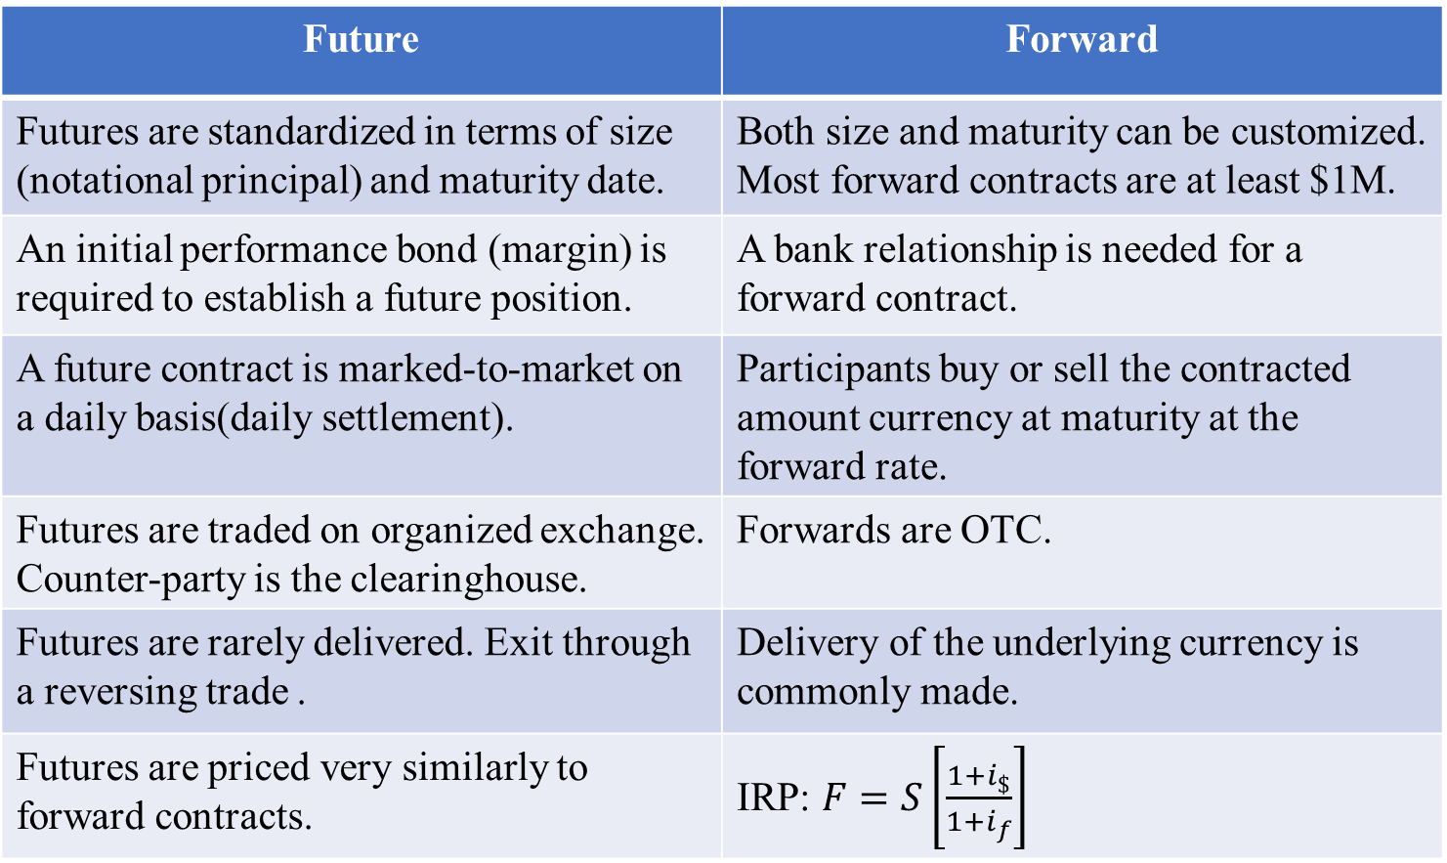
Foreign Currency Futures v.s. Forward Contracts
Future | Forward
Futures are standardized in terms of size (notational principal) and maturity date. | Both size and maturity can be customized. Most forward contracts are at least $1M.
An initial performance bond (margin) is required to establish a future position. | A bank relationship is needed for a forward contract.
A future contract is marked-to-market on a daily basis(daily settlement). | Participants buy or sell the contracted amount currency at maturity at the forward rate.
Futures are traded on organized exchange. Counter-party is the clearinghouse. | Forwards are OTC.
Futures are rarely delivered. Exit through a reversing trade . | Delivery of the underlying currency is commonly made.
Futures are priced very similarly to forward contracts. | IRP: $F=S\left[\frac{1+i_{\$}}{1+i_{f}}\right]$

Slide 7
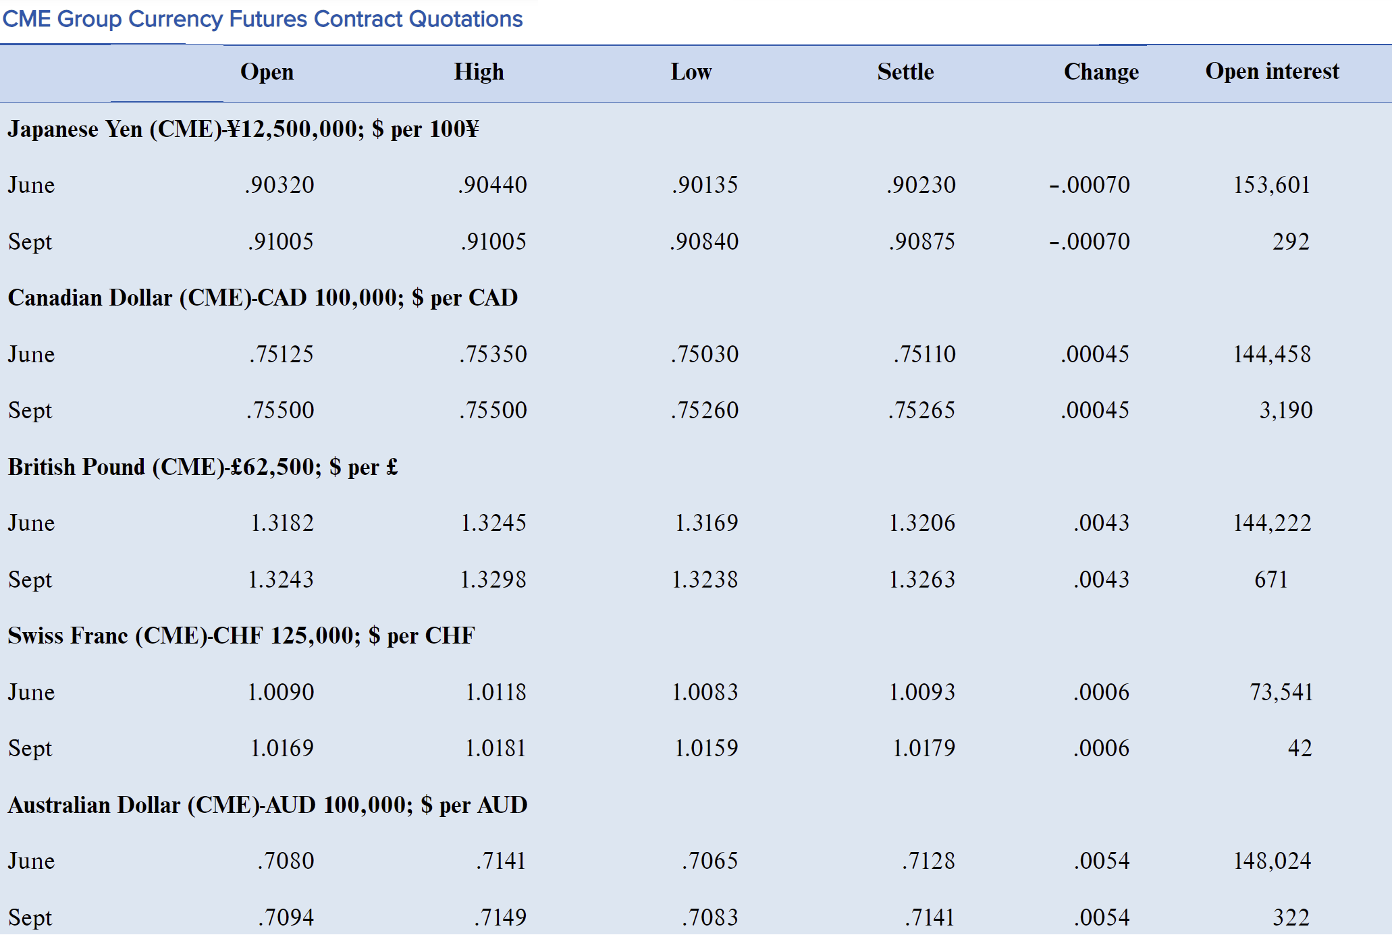
April 3, 2019

Slide 8
Daily Mark-to-market of Futures Contracts
Participants have daily settlement of gains and losses rather than one big settlement at maturity.
Every trading day:
Settlement for the long position=notational principal*Δ settlement price.
Settlement for the short position=notational principal*(-Δ settlement price. )
If the settlement price goes up, the buyer (long position) gains, the seller (short position) loses.
If the settlement price goes down, the buyer (long position) loses, the seller (short position) gains.
Zero-sum game.
Each day’s losses(gains) are subtracted(added) from(to) the investor’s performance bond account through the clearinghouse.
Initial performance bond (2% contract value).
If the investor’s performance bond account balance falls below the maintenance level. Additional funds are required to be deposited to the account to bring the balance back to the initial performance bond. Otherwise, the position will be closed out.
After the daily settlement, each party has a new contract at the new price with one-day-shorter maturity.

Slide 9
Foreign Currency Options
A foreign currency option is a contract giving the option buyer the right, but not the obligation, to buy or sell a given amount of foreign currency at a fixed price for a specified time period (until the maturity date).
The buyer of an option is termed the holder, while the seller of the option is referred to as the writer or grantor.
There are two basic types of options, calls and puts.
A call is an option to buy foreign currency.
A put is an option to sell foreign currency.
European versus American options:
European options can only be exercised on the expiration date.
American options can be exercised at any time up to the expiration date.

Slide 10
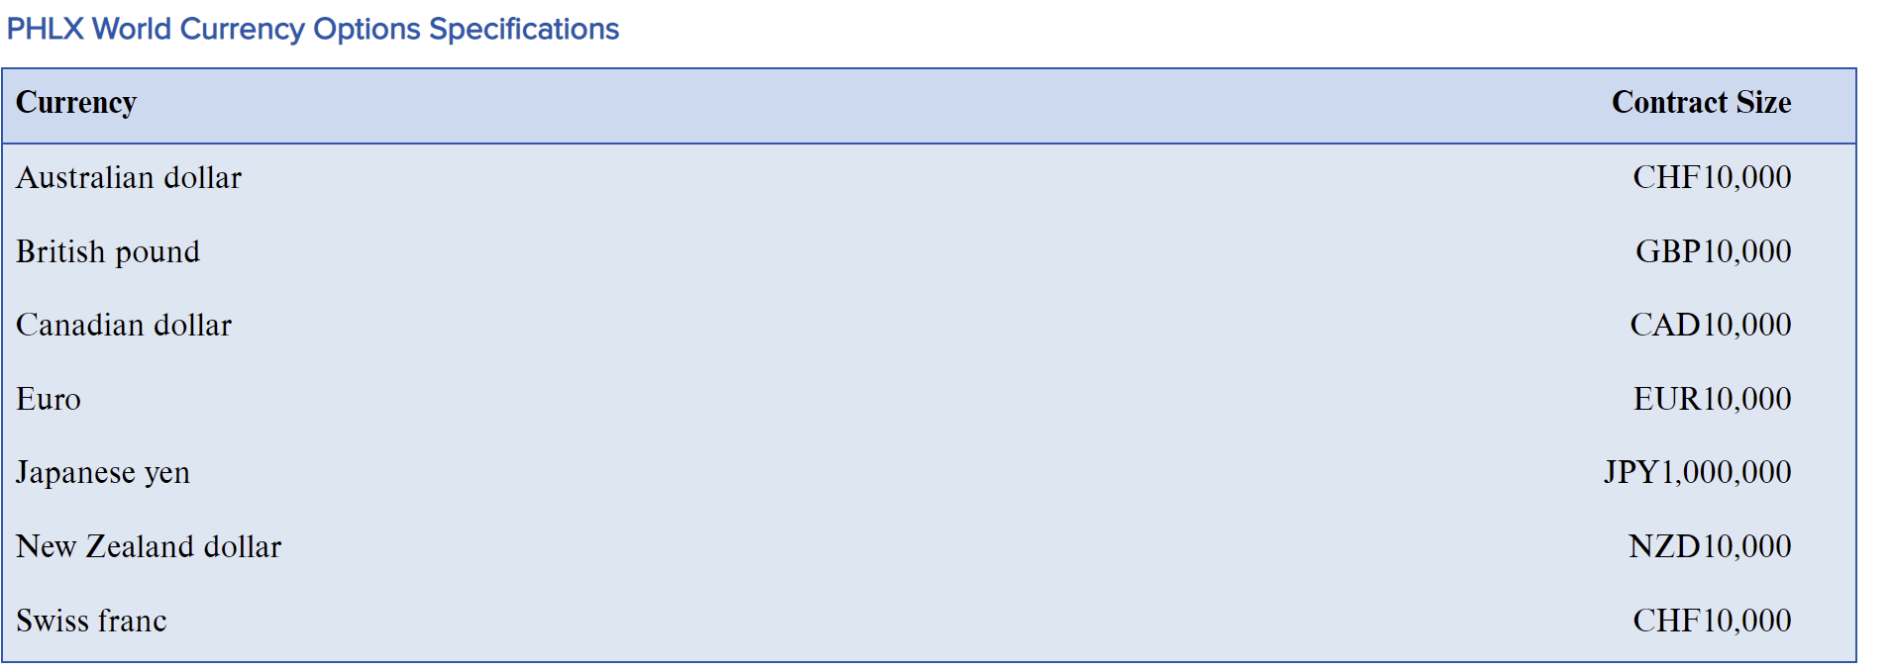
Options on the over-the-counter (OTC) market can be tailored to the specific needs of the buyer.
Options on organized exchanges are standardized and settled through a clearinghouse. The counterparty risk is largely reduced.
The volume of OTC options trading is much larger than organized exchange options trading.
The average daily OTC currency options trading volume was 294 billion.

Slide 11
Every option has three elements:
The exercise or strike price(E): the exchange rate at which the foreign currency can be purchased (call) or sold (put).
The premium: the cost, price, value of the option.
Premiums of OTC options are quoted as a percentage of the transaction amount.
Premiums on exchange-traded options are quoted as a domestic currency amount per unit of foreign currency.
The underlying or actual spot exchange rate in the market(S).
At-the-money (ATM): an option whose exercise price is the same as the spot price of the underlying currency.
In-the-money (ITM): an option that would be profitable if exercised immediately, excluding the cost of the premium.
For a call: exercise price <spot price,
For a put: exercise price >spot price.
Out-of-the money (OTM): an option that would not be profitable if exercised immediately, excluding the cost of the premium.
For a call: exercise price >spot price,
For a put: exercise price <spot price.

Slide 12
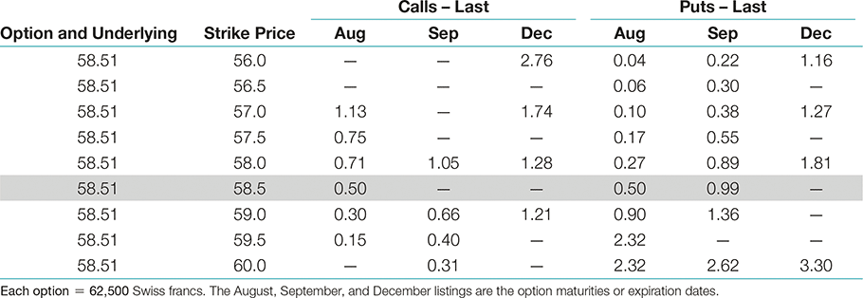
Swiss Franc option quotations (U.S. cents/SF)
All the quotes refer to transactions completed on the Philadelphia Stock Exchange on the previous day.
August 58.5 call option
Total cost of one call option=SF62,500 * $0.0050/SF = $312.50.

Slide 13
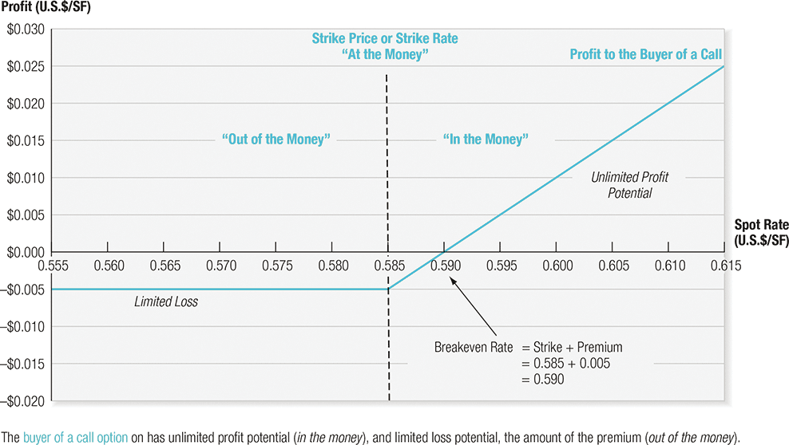
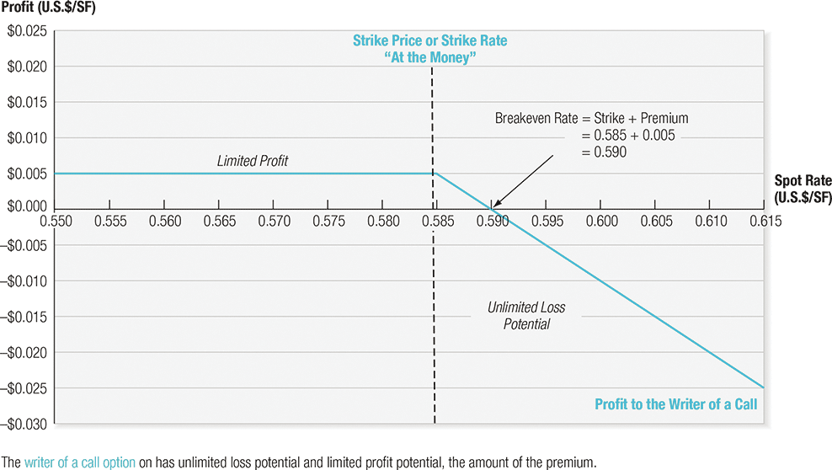

Slide 14
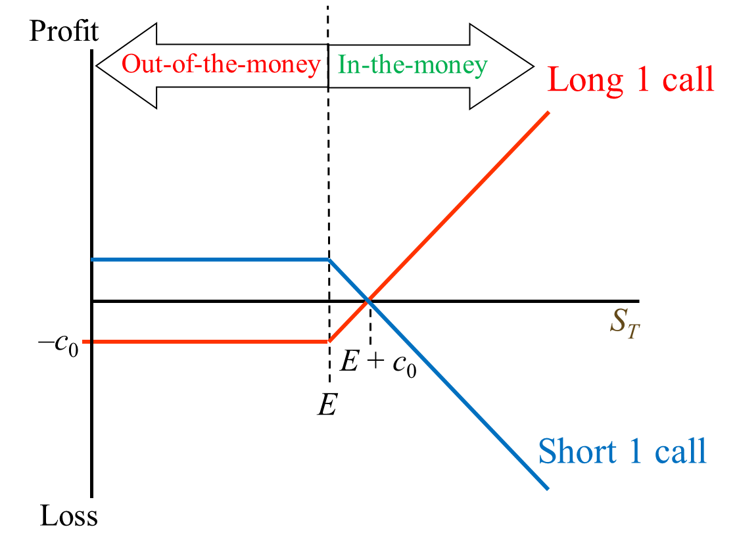
Profit diagram for a call option
Buyer of a call profit=Spot-Strike-premium
Writer of a call profit=Strike -Spot + premium
Zero-sum game

Slide 15
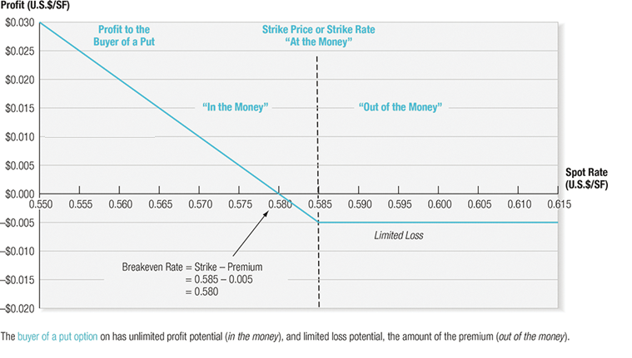
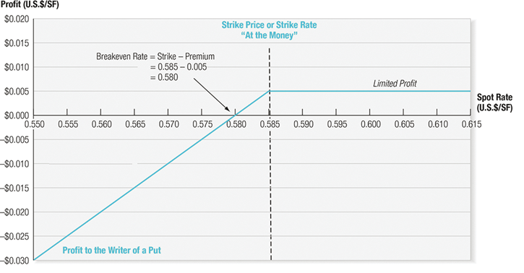

Slide 16
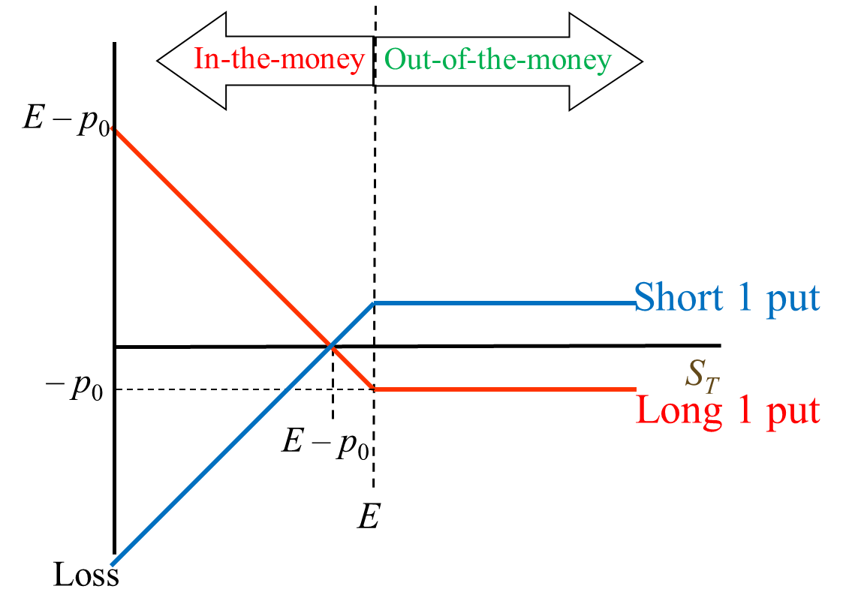
Profit diagram for a put option
Buyer of a put profit=Strike-Spot-premium
Writer of a put profit=Spot-Strike + premium
Zero-sum game

Slide 17
Option Pricing and Valuation
The total value (premium) of an option =intrinsic value + time value.
Intrinsic value is the financial gain if the option is exercised immediately.
For a call option, intrinsic value is zero when the strike price is above the market price. When the spot price rises above the strike price, the intrinsic value become positive.
Max[0, (S_{t}-E)]
Put options behave in the opposite manner.
Max[0, (E-S_{t})]
The time value of an option exists because the price of the underlying currency, (i.e. the spot rate), can potentially move further into the money between the present time and the option’s expiration date.
On the date of maturity, an option will have a value equal to its intrinsic value (zero time remaining means zero time value)

Slide 18
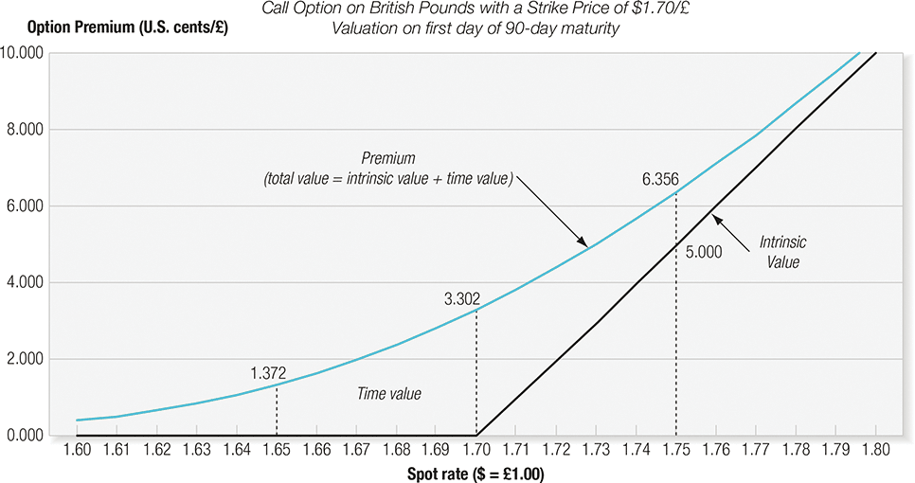
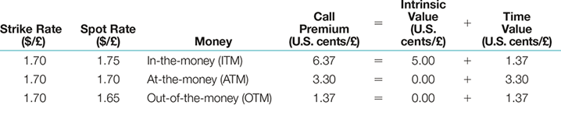
The total value of an option =intrinsic value + time value

Slide 19
Learning Objectives Revisit
Explain how foreign currency futures and options are quoted and used for speculation or hedging purposes.
Compare foreign currency futures and forwards.
Explore the gain or loss of participants in foreign currency futures and options.
Describe how foreign currency futures and options are priced.

